Slide 1
Microsoft Movie Studio Market Analysis
Aouther : Prince Obiero

Slide 2
Overview
This project explore current box office trends to help Microsoft make data driven decision as it enters the original movie production space.
Using dataset from IMDB and Box Office Mojo ,the analysis focuses on genre performance ,run time,audience ratings , and gross earnings.
The goal is to identify profitable film traits to inform strategic content development.

Slide 3
Business Problem
Microsoft is launching a new movie studio but lucks insight into what type of movies perform best commercially.
Understanding genre trends , runtime preferences , and audience reception can guide investment into films that maximize both critical and financial success.
Business Questions:
What type of movies generate the most revenue?
Do audience rating and number of votes correlate with higher gross?
How do gender and release year influence box office performance?

Slide 4
Data
Data sources:
imdb.title.basics.tsv.gz : Title, genre, runtime, year
imdb.title.ratings.tsv.gz : Average rating , number of votes
bom.movie_gross.csv : Domestic and foreign gross revenue

Slide 5
Methods
Data merged on unique film ID tconst
Missing values imputed appropriately(e.g, runtime mean)
Genres exploded for multi-genre analysis
Data modeling includes correlation analysis and group-based aggregation
Visualization tools: bar plots , heatmaps

Slide 6
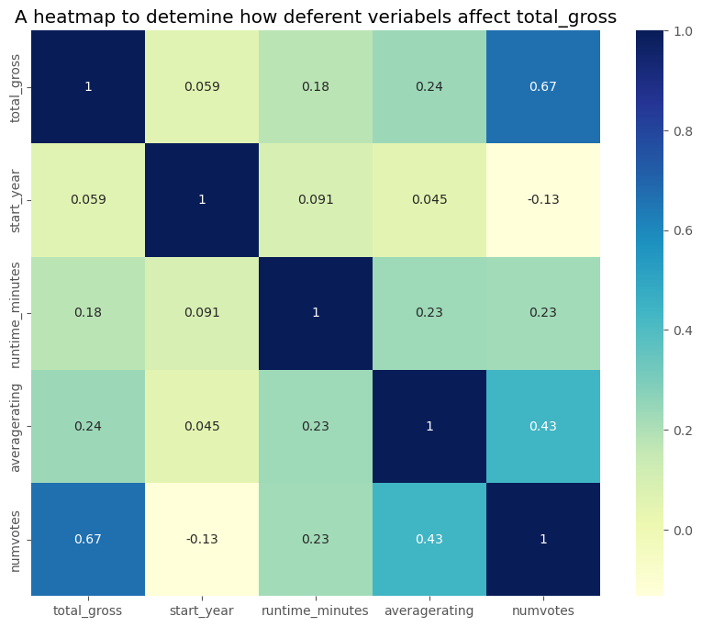
Correlation Heatmap

Slide 7
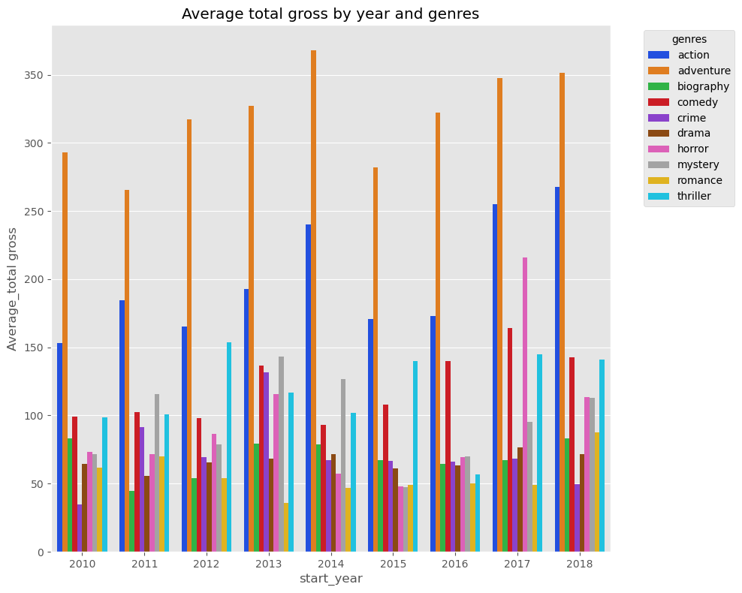
Bar Plot – Total Gross by Genre and Year:

Slide 8
Conclusions
Recommendations for Microsoft:
Focus on Action ,Adventure , and Biography genres to increase potentials
Support genres decisions with market trends data but also asses long term sustainability beyond blockbuster outliers
Consider highly rated and frequently voted titles as signal of appeal
Limitations
Data limited to films with complete financial information
No access to production budget or streaming metrics
Next Steps
Predict revenue using regression models on cleaned features

Slide 9
For more info:
Contact:
Email[princevalentine879@gmail.com]
Git Hub []

